Slide 1
BUSINESS AND PROFESSIONAL COMMUNICATION
BY: DR. AJIT ANAND

Slide 2
Outline
1- General Communication: Approaching the construct
A- Process; principles and models
B- From clarity to effectiveness
C- Barriers to effective Communication
2- Business communication
A- Objectives; Styles; and Scope
B- Format; ; Features and Applications
C- Business communication Vs General communication
D- Written Business communication and Netiqette

Slide 3
“I know that you believe that you understood what you think I said, but I am not sure you realize that what you heard is not what I “meant.”
Robert J. McCloskey (former US State Department spokesman)

Slide 4
“Live together like brothers and do business like strangers”
Arab Proverb ‘Scollons et al (2010)
“You will never know a man till you do business with him”
Scotish Proverb

Slide 5
The root of the word “communication” in Latin is communicare, which means to share, or to make common.
Communication is thus a process of understanding and sharing meaning.
The American Management Association defines ‘Communication as “any behavior that results in an exchange of meaning”.
“To understand is to perceive, to interpret, and to relate our perception and interpretation to what we already know.”
In communication, sharing occurs when you convey thoughts, feelings, ideas, or insights to others.

Slide 6
Components of Communication
1. Source
2. Message
3. Channel
4. Receiver
5. Feedback
6. Environment
7. Context
8. Interference

Slide 7
Transactional Model of Communication
When communication takes place, the source and the receiver send messages at the same time, often overlapping. Participants play both roles simultaneously.
The distinction between source and receiver is blurred.
Feedback gives instant important clues.

Slide 8
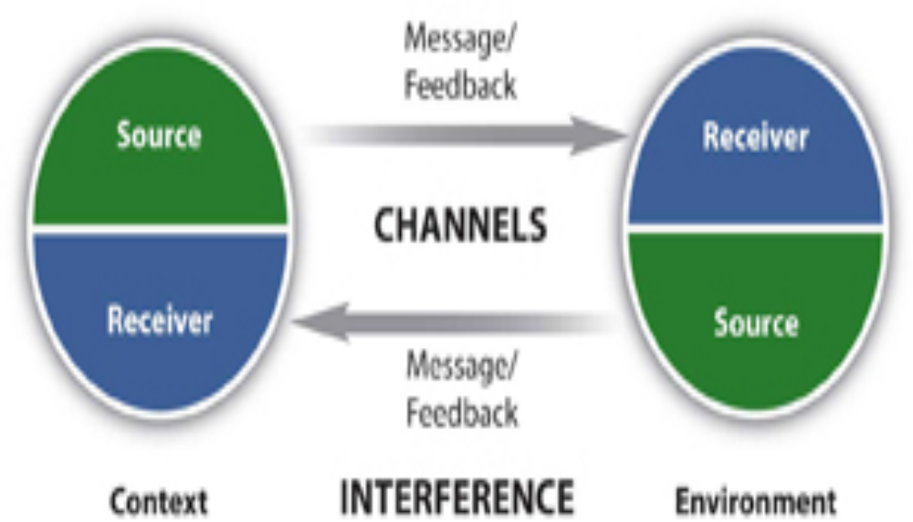
Transactional Model of Communication

Slide 9
Constructivist Model of Communication
We all construct our own interpretations of the message. what I said and what you heard may be different. We focus on the negotiated meaning, or common ground, when trying to describe communication. Because we carry the multiple meanings of words, gestures, and ideas within us, we can use a dictionary to guide us, but we will still need to negotiate meaning.
(Examples of Tide or Coke in Atlanta)

Slide 10
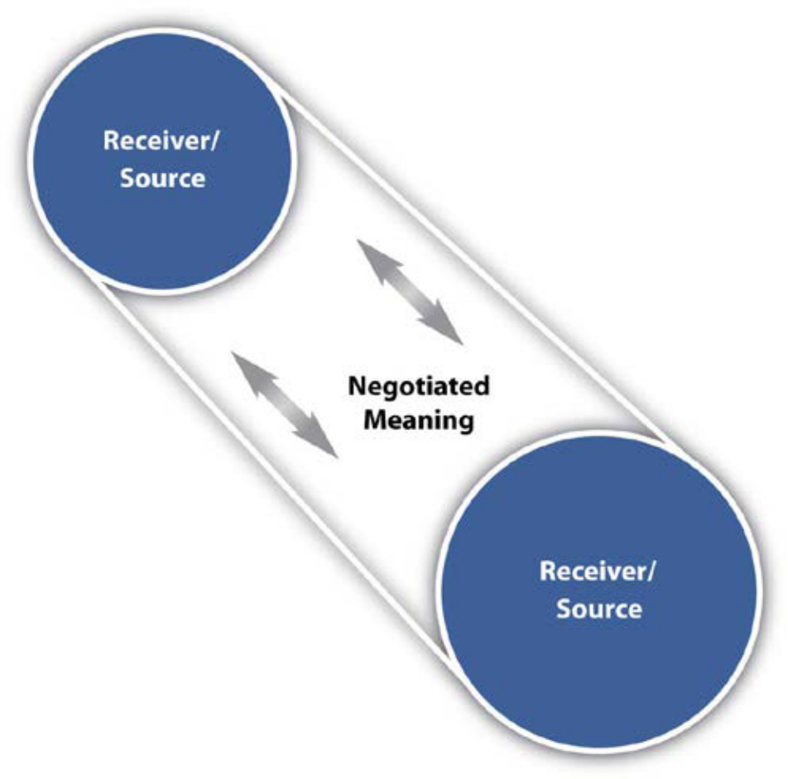
Constructivist Model of Communication

Slide 11
The Seven C’s of Effective Communication
Completeness: The communication must be complete. It should convey all facts required by the audience. The sender of the message must take into consideration the receiver’s mind set and convey the message accordingly.
Conciseness: Conciseness means wordiness, i.e, communicating what you want to convey in least possible words without forgoing the other C’s of communication. Conciseness is a necessity for effective communication.
Consideration: Consideration implies “stepping into the shoes of others”. Effective communication must take the audience into consideration, i.e, the audience’s view points, background, mind-set, education level, etc.

Slide 12
The Seven C’s of Effective Communication
Clarity : Clarity implies emphasizing on a specific message or goal at a time, rather than trying to achieve too much at once.
Concreteness: Concrete communication implies being particular and clear rather than fuzzy and general. Concreteness strengthens the confidence.
Courtesy: Courtesy in message implies the message should show the sender’s expression as well as should respect the receiver. The sender of the message should be sincerely polite, judicious, reflective and enthusiastic.
Correctness: Correctness in communication implies that there are no grammatical errors in communication.

Slide 13
“The Miscommunication Gap,” Susan Washburn(2008)
• Damaged relationships
• Loss of productivity
• Inefficiency
• Conflict
• Missed opportunities
• Schedule slippage (delays, missed deadlines)
• Scope creep…or leap (gradual or sudden changes in an assignment that make it more complex and difficult than it was originally understood to be)
• Waste of resources

Slide 14
From ‘hard’ to ‘soft’ Skills
The National Association of Colleges and Employers (2012):
-Oral and written communication proficiencies are consistently ranked amongst the top ten desirable skills by employer surveys”
-High-powered business executives sometimes hire consultants to coach employees to sharpen their communication skills.

Slide 15
What Is Business Communication?
Ricks and Gow “Business communication is a system that affects change within the total organization.”
W. H. Meaning “The exchange of ideas, news and views in connection with the business among the related parties is called business communication.”
J. Haste “Communication that occurrs between two or more businessmen for organizing and administering business efficiently is called business communication.”
F. Brennar “Business communication is the channeling, receiving and interchanging of ideas in commerce and industry.”

Slide 16
Objectives of business communication
Achieving organization goals Exchanging of information Formulating and executing plans Increasing efficiency Directing the subordinates Creating consciousness Coordinating and cooperating Persuading Facilitating joint effort Educating and training employees | Developing labor-management relations Creating relationship with external parties Monitoring and controlling the activities Solving problem Initiating to change Making Decisions Raising awareness to future change Building image

Slide 17
Business Communication: A typology
Business to Business
-This is any communication that is done from one business to another.
-Business-to-business relationships are vital for a strong and successful business and can help strengthen your bottom line.
Business to Employees
-This is any corporate communication, whether it is information, correction or encouragement.
-Effective communication to employees is crucial to prevent misunderstandings and promote unity of thought and process throughout the entire organization.

Slide 18
Business Communication: A typology
Interdepartmental Communication
-When interdepartmental communication is ineffective it affects the customer and the employees.
-A communication breakdown between departments makes the business appear incompetent.
Business to the Public
-Communication to the public is typically in the form of promotion or advertising and can be very effective in generating new clientele.
-Other forms of communication to the public are public relations and media coverage and corporate statements.

Slide 19
Modes of Business Communication
Verbal communication
-It may include: meetings, in-person interviews, telephones and video conferencing.
-It may be the best communication method because it allows people to assess the verbal or nonverbal inferences by individuals giving a message.
-It may create a more comfortable environment for receivers to ask questions and get feedback from individuals giving the message.

Slide 20
Modes of Business Communication
Written communication
-It includes: internal business memos, formal letters, bulletin boards or posters and other various written communication forms.
-Ideal for reaching multiple individuals at different locations with a similar message.
-It may also help senders convey technical messages that have several instructional steps, such as diagrams and charts .
-It may create a paper trail for important messages. Individuals may be required to acknowledge receipt of the message or respond within a limited time frame.
- Useful for ensuring documentation, correcting an issue or dealing with important legal situations.

Slide 21
Modes of Business Communication
Electronic communication
-It includes: emails, web conferencing, social networking, company websites, online chat and text messages.
-Allows companies to send mass messages to several individuals quickly at a low business cost.
-Often used to reach outside business stakeholders or the general public. Organizations may create several different electronic communication channels to reach different target markets or demographic groups with their message.
- It is also used to communicate with international organizations or individuals in an efficient manner.

Slide 22
Characteristics of Business Communication
Segmented
Effective business communication is segmented to meet the needs of specific audiences.
Employees working in an administrative setting, for instance, will have different needs--and different access to information--than employees working in a manufacturing environment.
Specific
Generic business communication doesn't meet the needs of anyone. Effective business communication is specific. “The more specific communication is, the more it meets the needs of its audience” Lin Grensing-Pophal (2005)
Accurate
When information is inaccurate it loses its credibility.. Effective business communication is accurate in terms of the content conveyed and in terms of simple things that include grammar, spelling and punctuation.

Slide 23
Characteristics of Business Communication
Timely
-Employees need to know what is going on - in a timely manner- in their organizations--and in the external environment--that impacts them.
Frequent
-It cannot be assumed that a message has gotten across if it is sent just one time.
-Effective business communication occurs frequently to ensure that it has been received by all employees.
-Employees leave, new employees join the company and employees transfer from one role to another, requiring new and updated information.

Slide 24
Characteristics of Business Communication
Multi-Channel
Effective business communication needs to be sent through a broad variety of channels to ensure that it is received by employees in different settings. (print, bulletin boards, meetings) to the new-technology (email, blogs, social media sites).
Face-to-Face
Face-to-face communication is still the most effective (Grensing-Pophal). Alternatives may include videoconferencing or the use of webinars.
Two-Way
Employees need the opportunity to share their feedback, opinions and thoughts with managers and employers

Slide 25
Business Communication Vs general communication
Business communication | General communication
1- Business communication follows the officially established chain of command and lines of communication. 2. It is a slow moving process. 3. It is easy to pinpoint the responsibility with respect to business communication 4. It is task-oriented . 5. It consists mainly of work-related matters. | - General communication is independent of the authority relations in the organization -t carries message at a fast speed -It is not possible to fix the responsibility of general communication. -It is people oriented. -It may consist of work related as well as social message.

Slide 26
Business Communication Vs general communication
Business Communication is more formal, direct and well organized and General Communication is less formal, indirect and not well organized.
Business Communication uses certain formats to convey messages and General Communication has Different formats which are used according to the will of the communication.

Slide 27
Business Communication Vs general communication
Business Communication leaves no scope of using personal feelings or emotions or opinion in business messages and General Communication allows for personal feelings, emotions and opinions take most of the part.
Business Communication always deals with practical information and General Communication may contain factious information.
Business Communication is impartial and objective and General Communication may be partial and subjective.

Slide 28
Business Writing (E-mails)
-E-mail can be very useful for messages that have slightly more content than a text message, but it is still best used for fairly brief messages.
-Many businesses use automated e-mails to acknowledge communications from the public, or to remind associates that periodic reports or payments are due.
-E-mails may be informal in personal contexts, but business communication requires attention to detail, awareness that your e-mail reflects you and your company, and a professional tone so that it may be forwarded to any third party if needed.
-Although e-mail may have an informal feel, remember that when used for business, it needs to convey professionalism and respect. Never write or send anything that you wouldn’t read in public or in front of your company president.

Slide 29
Tips for Effective Business E-mails
Proper salutations should demonstrate respect and avoid mix-ups in case a message is accidentally sent to the wrong recipient.
Subject lines should be clear, brief, and specific. This helps the recipient understand the essence of the message. For example, “Proposal attached” or “Your question of 10/25.”
Close with a signature. Identify yourself by creating a signature block that automatically contains your name and business contact information.
Avoid abbreviations. An e-mail is not a text message, and the audience may not find your wit cause to ROTFLOL.

Slide 30
Tips for Effective Business E-mails
-Be brief. Omit unnecessary words.
-Use a good format. Include line breaks between sentences or divide your message into brief paragraphs for ease of reading. A good e-mail should get to the point and conclude in three small paragraphs or less.
-Reread, revise, and review. Catch and correct spelling and grammar mistakes before you press “send.” It will take more time and effort to undo the problems caused by a hasty, poorly written e-mail than to get it right the first time.
-Reply promptly. Watch out for an emotional response -never reply in anger-but make a habit of replying to all e-mails within twenty-four hours.

Slide 31
Tips for Effective Business E-mails
“Reply All” sparingly. Do not send your reply to everyone who received the initial e-mail unless your message absolutely needs to be read by the entire group.
Avoid using all caps. Capital letters are used on the Internet to communicate emphatic emotion or yelling and are considered rude.
Test links. If you include a link, test it to make sure it is complete.

Slide 32
E-mail ahead of time if you are going to attach large files (audio and visual files are often quite large) to prevent exceeding the recipient’s mailbox limit or triggering the spam filter.
Give feedback or follow up. If you don’t get a response in twenty-four hours, e-mail or call. Spam filters may have intercepted your message, so your recipient may never have received it.

